Slide 1
How to Protect Yourself From Identity Theft
The Palm Beach County Association of Chiefs of Police
Public & Private Partnership Workgroup
Presents

Slide 2

Do You Know If You Are Vulnerable?
Yes!
We are all Vulnerable!

Slide 3
Identity Theft

Slide 4
Identity Theft Is…
When a person knowingly transfers or uses, without lawful authority, a means of identification of another person with the intent to commit, or to aid or abet, any unlawful activity that constitutes a violation of Federal law, or that constitutes a felony under any applicable State or local law.

Slide 5
Historically,
Identity Theft is…
When a person who knowingly and without authorization fraudulently uses, or possesses with the intent to fraudulently use, personal identification information concerning an individual without first obtaining that individual’s consent, and may include;
  Using your personal information to open a new account
  Purchase vehicles
  Apply for loans or credit cards
  Establish services
  Rent homes, apartments and or vehicles

Slide 6
Laws Were Enacted to Criminalize Identity Theft
In 1998
Congress passed the
Identity Theft and Assumption Deterrence Act
(18 U.S.C. ~ 1028)

Slide 7
Florida’s Response to Identity Theft
In October 2001 the State of Florida passed into law
Florida Statue 817.568
making Identity Theft a felony

Slide 8
Identity Theft
Stealing a persons identity is easier now than at any time in the past, thanks to computers and public access to personal data.
The very nature of the crime often makes the perpetrator difficult to identify and prosecute.

Slide 9
How Many ID Theft or Fraud Cases in 2015 ?
19.6 Million cases of ID theft were reported

Slide 10
Identity Theft Criminals
1 in 1000 Identity thieves will go to jail…
  Florida is # 1 in Identity theft
  Florida is # 1 in violent crimes
  1 in 3 will be a victim this year!

Slide 11
What Do They Want?
Your name
DOB
Address
Telephone numbers
Drivers license numbers
Credit account numbers
Bank account numbers
Social Security number
You and your mothers maiden name
Any information that can identify you to the exclusion of others

Slide 12
How Does It Occur?
They steal your wallets or purses containing your identification.
They steal your mail, including your bank and credit card statements, pre-approved credit offers, telephone calling cards and tax information.
They complete a change of address form to divert your mail to another location.
They go through your trash, or trash of local banks and businesses.
They fraudulently obtain your credit report posing as a business owner or landlord, etc.
They get your personal information from records where you work, or the club you have a membership at.

Slide 13
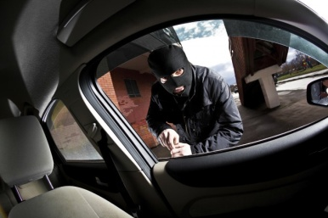
Vehicle Theft or Burglary:
Persons break into or steal your vehicle with all of your personal information in them. Don’t be a victim!
  Lock your doors!
  Do not leave valuables in plain view
  Secure your personal belongings and items
  Only have the documents required by law
  Redact your personal information

Slide 14


Stolen Wallet or Purse:
When a thief steals your wallet or your purse, they gain instant access to the information they need to take the next step and steal your identity.

Slide 15

P2P File Sharing:
Music sharing sites and other peer-to-peer networks have helped high-tech thieves get all kinds of personal information via accidental disclosure—tax returns, password files, birth dates, and account numbers. Anything stored on the same hard drive as the shared library can inadvertently go public when you connect.

Slide 16

Dumpster Diving:
This method of identity theft is one of the most traditional—and most effective. Thieves search your trash for documents that contain your personal information and gain access to important numbers that help them commit identity theft.

Slide 17

Phishing:
These days, that email from your bank in your inbox could be real—or a phishing attempt. Today's thieves are busy impersonating legitimate businesses via email and websites in order to acquire your personal information like PINs, credit card or bank account numbers, or Social Security number information.

Slide 18

Shoulder Surfing:
The prevalence of cameras and recorders in today’s mobile phones make this form of identity theft a real threat.
Thieves position themselves within sight or earshot of your latest credit application, and record your information to commit future identity theft.

Slide 19

Overlays:
Hidden devices can be installed almost imperceptibly on any ATM, enabling thieves to swipe your account information when you insert your card, and then transmit your account information to a nearby computer for future fraudulent use.

Slide 20

SMSishing:
Thieves are employing a sneaky new trend to get your personal info—sending text messages to your mobile device that impersonate a reputable contact and then direct you to a dangerous website with the goal of stealing your identity.

Slide 21

Vishing:
Email, texting, and websites are not the only way thieves are phishing for personal information. Vishing—voice calls made to your landline or mobile phone—is an effective way for thieves to get your personal information.

Slide 22

Keystroke Logging:
Keystroke logging is one of the most advanced forms of malware criminals can use to register your passwords, login IDs, and account information—without you even knowing it!

Slide 23
Next Generation Identify Theft
Malware, Malicious Software, Viruses, Worms, Trojan Horses, Spyware, and Rootkits:
Cyber thieves can install malicious software to exploit weaknesses in features of many popular software titles. Once installed, malware can run executable programs on your computer without your consent, including transmitting personal information via the Internet to remote computers, where it is stored and sold at a later date to counterfeiters.

Slide 24

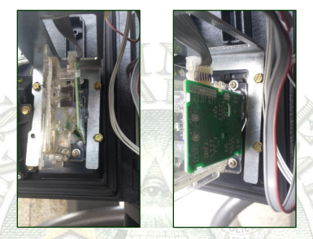
ATM Skimmers/Handheld Skimmers: Today's thieves are innovating the way they steal your personal information, by swiping it–literally–when you are in the midst of a legitimate transaction such as paying for dinner bill at a restaurant, pumping gas, or using an ATM.

Slide 25
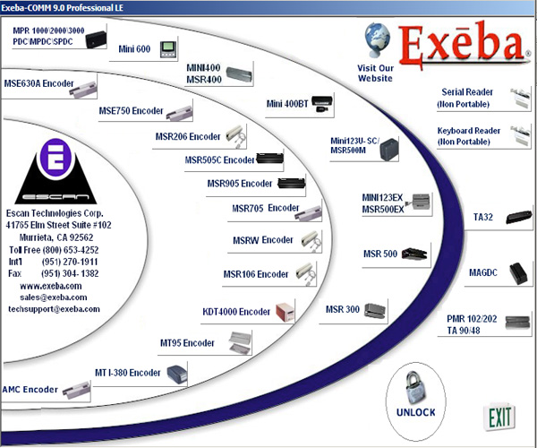
New Skimming Devises Found Online

Slide 26

New Technology

Slide 27

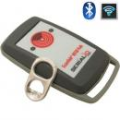
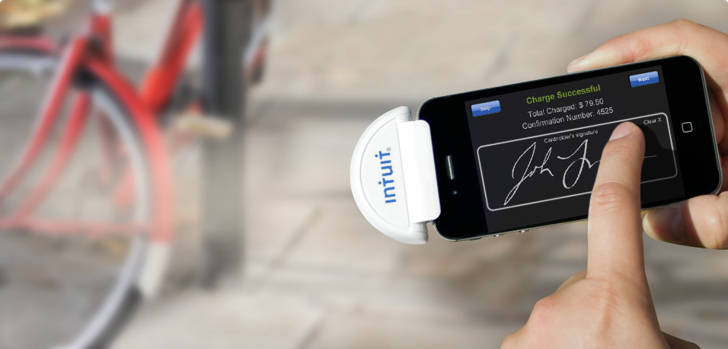
New Technology

Slide 28
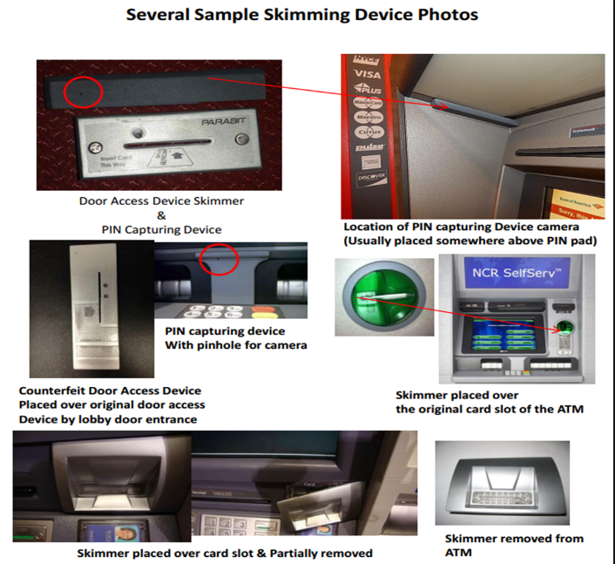
Can you see the Devices?

Slide 29
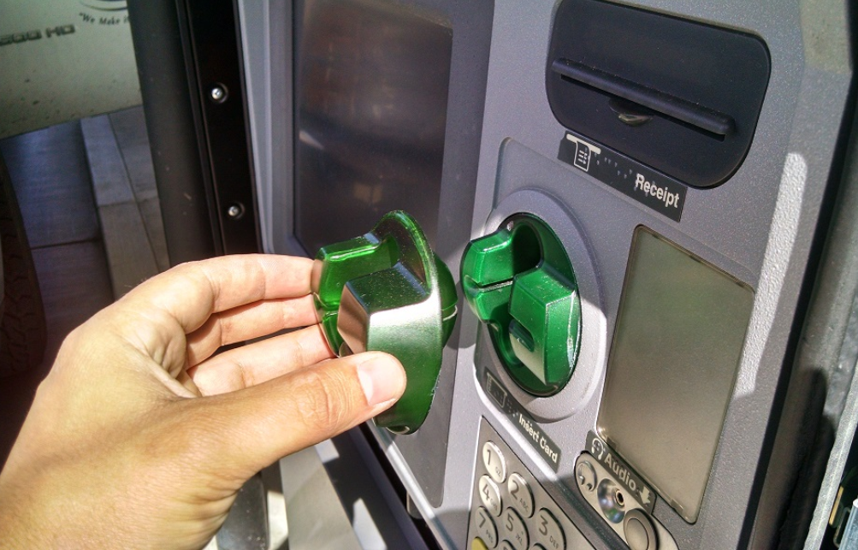
Most Common Bank Skimmer

Slide 30
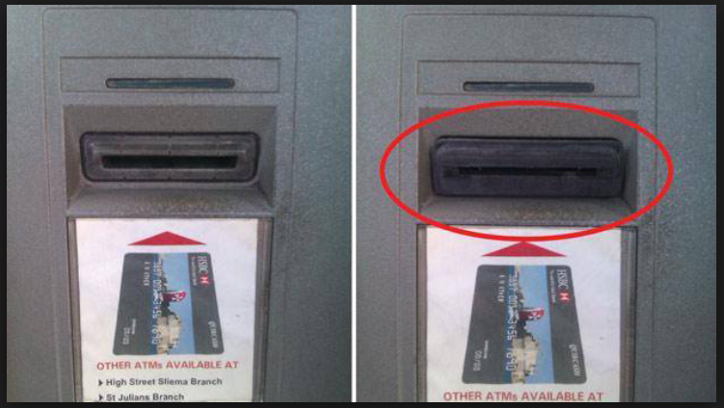
Found in Lake Park, Florida

Slide 31
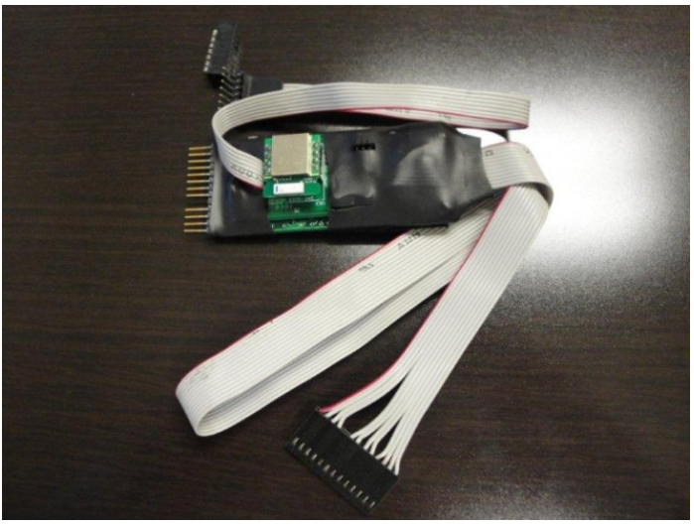
Found in West Palm Beach, Florida

Slide 32
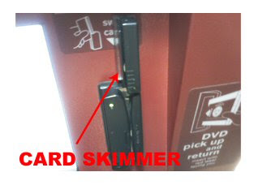
Found in Pt St. Lucie, Florida

Slide 33
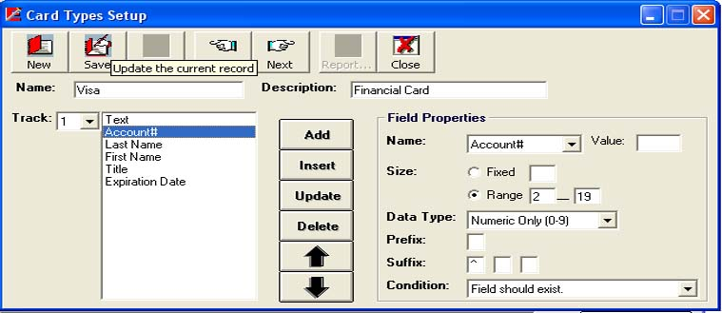
How to Make a New Credit Card
Identity thieves can buy and use Credit Card making machines for a very low cost.

Slide 34


Who Steals Your Identity?
Maria Johnson
Markia Williams
A 43-year-old convicted of identity thief was recently arrested again after she allegedly assumed the identities of other people . She was able to “live the high-dollar lifestyle of the cafe society entirely off stolen identities.” Se was given a $2,000,000.00 bond.
Connecticut State Police arrested a 19 year old Pennsylvania woman on identity theft charges after they stopped a brand new 2016 BMW they said may have been purchased with fake ID. She had over 40 identification cards and 100 fraudulent credit cards in her purse at the time of the stop.

Slide 35
What Do They Do With Your Identification?
They call your bank or credit card company and change your mailing address for the card.
They have second cards issued in their names for personal use
They open new accounts using your name, date of birth and SSN.
When the cards go delinquent and the bill is not paid, it is reported on your credit report
They establish phone or wireless accounts in your name
They make on-line purchases so they can not be tracked and have them delivered to a Mailbox Exedra location.
They open a checking account and bounce the checks in your name
They get large credit accounts by buying cars, boats, etc.

Slide 36
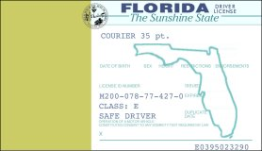
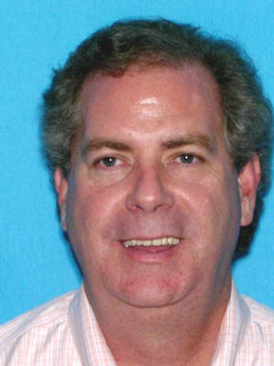
How Easy is It?
This is a Florida Drivers License blank used to make false Identification

Slide 37
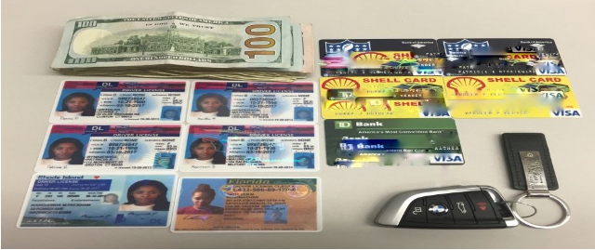
Is this your ID ?
Examples of Fake/False ID’s and Fraudulent Credit Cards Confiscated from Markia Williams

Slide 38
The New ID Theft…
Fraudulent IRS Tax Filing
Tax Fraud: When someone uses your information to file a fraudulent tax return, he or she is looking to get your tax refund.
You'll want to work with the IRS as soon as you discover the identity theft to ensure that your actual return is processed as quickly as possible.
In many cases, when someone files a tax return using your Social Security number, you won’t find out until after the second return is filed. The second return could be from you or the person who has stolen your information.

Slide 39
When Will You Know… ?
When the IRS receives two different returns with the same Social Security number, the second return filed will be rejected if you e-filed or if you paper-filed you’ll get a written notice that explains that a return has already been filed if you paper filed your return.
Even if you don’t get a letter from the IRS but suspect a fraudulent return has been filed with your information, you can still take action!

Slide 40
You Should Take Action Quickly!!
IRS Form 14039:
When you discover another a tax return has been filed with your Social Security number, you’ll use IRS Form 14039 to alert the IRS.
When you complete this form, you’ll indicate that someone has stolen your identity and it has affected your tax account since they have filed a return using your identifying information.
You’ll also provide information about the tax year affected and the last return you filed prior to the identity theft.

Slide 41
Tax Refund Fraud ?
If you are a victim, you will be notified by the IRS via Notice or a Letter. The IRS “does not” contact taxpayers by email to request personal or financial information!
Respond immediately to any IRS Notice and call the number provided on the notice.
Continue to pay your taxes or file your tax return!
You Must first fill out a IRS form 4506 (requesting a copy of the Tax return on file) this will give you access to the fraudulent IRS tax return, if you do not, the IRS will not give it to you once the 14039 report is filed.
Then file a IRS form 14039 (ID theft Affidavit)

Slide 42
Sending Form 14039
After you complete the 4506 form, you should complete Form 14039, mail it to the IRS with a copy of your Social Security card and driver’s license. If you don’t have a driver’s license, you can substitute a U.S. Passport, military ID or other government-issued identification card.
If you received an IRS notice concerning the fraudulent return, include a copy of the notice. Mail the form and documents to the address shown in your notice.
If you did not receive an IRS notice, mail your documents to:
Internal Revenue Service
P.O. Box 9039
Andover, MA 01810-0939

Slide 43
Request for Identity Verification from the IRS
When the IRS stops a suspicious tax return filing, they may send a letter called "Letter 5071C" asking that you verify your identity. It will include a couple ways to verify it: via a phone number or through the IRS's Identity Verification Service, https://idverify.irs.gov.
This online service is the quickest method and will ask you multiple-choice questions to verify whether or not the tax return flagged for further identity verification was filed by you or someone else. The IRS only sends such notices by mail.
The IRS will not request that you verify your identity by contacting you by phone or through email. If you receive such calls or emails, they are likely a scam. If you can't confirm your identity using the IRS' online Identity Verification Service, you can call the IRS at the phone number included in the letter. When confirming your identity, you will need:
  Your name, date of birth and contact information
  Social security number (SSN) or individual taxpayer identification number (ITIN)
  Your prior year tax return along with supporting documents such as W-2s, 1099s, and Schedules A and C if you filed them

Slide 44
Minimize your Risk!
Manage your personal information wisely
Find out how your personal information is secured with your bank and credit card companies and the confidential procedures at the bank or company
Pay close attention to your billing cycles
Follow up with creditors if your bills show late payment
Check every transaction on your accounts
Keep your receipts and check them against your statements
Take your outgoing mail to the post office and place it in the box. Using your house mailbox makes it easy to see when items are going out
Get your mail from your box quickly
Shred all bills and documentation you dispose of !

Slide 45
Minimize your Risk!!
Notify the Postal Service when you are going to be away ( 1-800-275-8777 ) and ask for a vacation hold on your mail
Put passwords on all of your credit cards, bank & phone accounts
Have “Credit Alert” or Credit Aware” protection on your accounts through American Express, Sears, AAA, VISA and other companies
Lock your vehicle, home and workspace!

Slide 46
Be Careful Who You Talk to….
Telephone solicitation is a quick way to be taken as a victim.
Know who you are talking to.
Call your local police to find out if they are affiliated with a law enforcement agency
Most companies asking for donations give less than 3 % of what they take in to the agencies they say they represent. Ask them what percentage goes to the actual law enforcement agency

Slide 47
What Should I do If I Become a Victim…
You Must Act immediately to minimize the damage to your personal funds, financial accounts as well, your personal reputation!
File a report with your local police or the police in the community where the identity theft took place.
Go to the FTC web site and:
  File a complaint with the Federal Trade Commission.
  Place a fraud alert on your credit reports, and review your credit reports.
  Close the accounts that you know, or believe, have been tampered with or opened fraudulently.

Slide 48
Federal Trade Commission
Go to:
www.ftc.gov
Go to the website and follow the instructions within.

Slide 49
You Must Move Quickly !
It is important to move quickly when you realize that you have become a victim of Identity Theft !

Slide 50
Checking your Credit
You must quickly check your credit to see if there are other accounts open in your name you may not be aware of.
Here are the Credit Bureau numbers to check your credit report for identification theft:
Equifax www.equifax.com 1-800-685-1111
Experian www.experian.com 1-800-397-3742
Transunion www.transunion.com 1-800-916-8800

Slide 51
Today, the United States is Under Attack!!!
Cyber Crimes:
Cyber Crime is defined as using a computer to perpetrate a crime. This includes anything from down loading movies to music, games to ordering product from Amazon, E-Bay or any other sales company with a fraudulent or stolen credit card number.
It can also be for non-monetary purposes such as:
Denial of services
Cancellation of services
Defame a website
Hold your website hostage
Sell your personal information to other criminals

Slide 52
In Closing…
You must prepare for crime against you, whether in person, in your vehicle, in your home, or on your computer.
You must be ready and be consciences of your surroundings
You must take your safety serious
You must take your families safety serious
Prevention and preparation strategies will keep you from becoming victim!

Slide 53
















The Palm Beach County Association of Chiefs of Police
Wishes to thank the following private partners for contributing to this important message.

